Slide 1

ROUND 1 BASELINE DIAGNOSTIC
Reference Year: 2017
n = 1,363 Respondents
Workplace
Readiness
Survey
Graduate Employability and Workplace Preparedness
in Nigerian Higher Education
A Quantitative System-Level Analysis
Research Lead
Commissioned By
Program
Dr. Olumuyiwa A. Oludayo
Nathan Leadgate Limited
The Workplace Survey

Slide 2
NAVIGATION
Executive Overview
01
Research Context & Methodology
02
The Preparedness Paradox
Survey framework, analytical constructs, and baseline approach
Breadth vs. depth analysis of graduate readiness
03
Capability Formation Gap
04
Experiential Learning Dominance
Skills acquisition paradox and curriculum design
Internships as the primary employability lever
05
Employability Signalling Deficit
06
Institutional Support Gap
Hidden barriers to labor market entry
The utilisation paradox in career services
07
Graduate Mindset & Values
08
Strategic Implications
Optimism and purpose-driven orientation
Actionable recommendations for stakeholders
Evidence-based insights for higher education transformation
Target Audience: Higher Education Stakeholders

Slide 3
01 / RESEARCH FOUNDATION
Research Context and Methodology
Survey Purpose
1,363
Round 1 serves as a baseline diagnostic to quantitatively establish patterns of graduate workplace readiness across the Nigerian higher education sector. This evidence-based approach shifts the conversation from anecdotal concerns to data-driven policy design.
Valid Responses
Statistically significant sample size
Methodological Framework
Analytical Constructs
Design
Data Type
Descriptive, cross-sectional survey
Self-reported perceptions
1
Self-Perceived Readiness
Population
Level
2
Capability Formation
Graduates & final-year students
System-level (national)
3
Experiential Learning
Key Insight
4
Employability Signalling
Findings reported at aggregate national level—not institutional performance assessment
5
Institutional Infrastructure
6
Career Orientation & Values
7
University Satisfaction
8
Workplace Literacy
Reference Year: 2017
Instrument: Workplace Preparedness and Fitness Survey

Slide 4
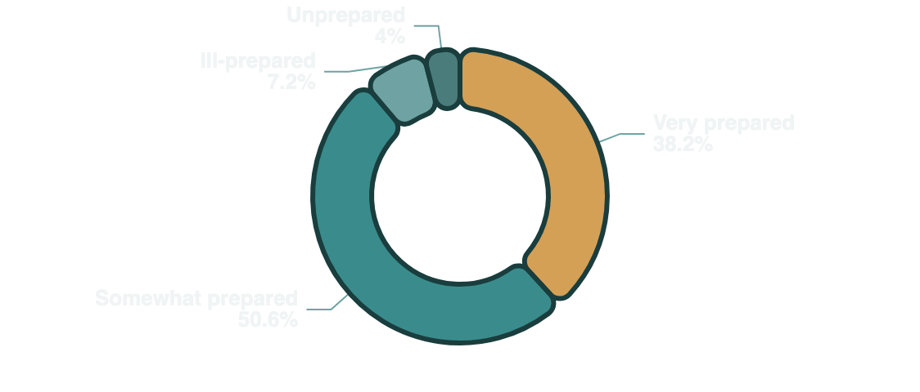
02 / KEY FINDING
The Preparedness Paradox: Breadth vs. Depth
The Central Challenge
While 88.8% of graduates feel at least "somewhat prepared," only 38.2% report being "very prepared" for professional work.
88.8%
38.2%
Preparedness Breadth
Preparedness Depth
At least somewhat prepared
Very prepared
Complete Distribution
Very prepared
38.2%
Strategic Implication
The "Somewhat Prepared" majority (50.6%) represents a critical intervention segment. Targeted investments in experiential learning and workplace exposure could significantly deepen professional readiness for over half of the graduate population.
Somewhat prepared
50.6%
Ill-prepared
7.2%
Unprepared
4.0%
What This Means
Confidence exists but depth is lacking
Majority ready for surface-level entry
Clear opportunity for targeted intervention
Survey Item: "How prepared do you feel for your professional career?"
n = 1,363

Slide 5
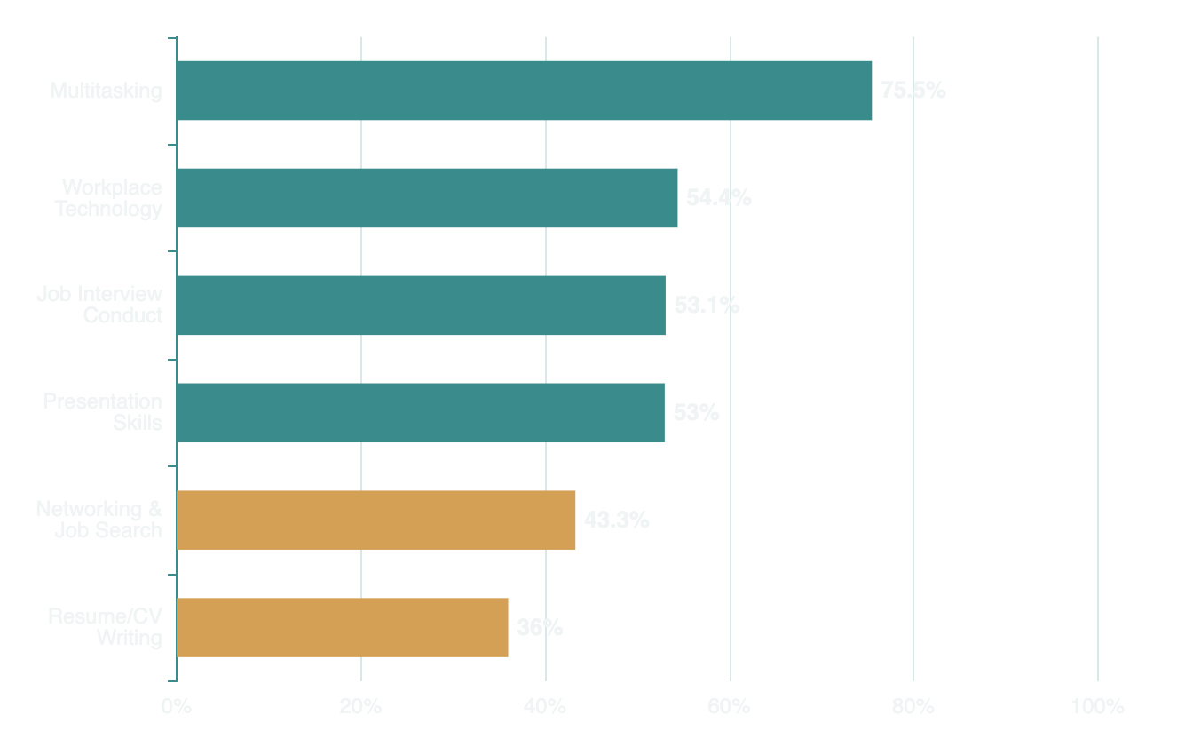
03 / CAPABILITY ANALYSIS
Capability Formation: The Skills Acquisition Paradox
The Paradox at a Glance
High Acquisition Skills
Universities excel at cognitive skills but structurally neglect employability signalling tools . This creates a fundamental barrier for graduates to effectively communicate their value to the labor market.
Multitasking
75.5%
Workplace Technology
54.4%
Job Interview Conduct
53.1%
Presentation Skills
53.0%
Critical Gaps
Networking/Job Search
43.3%
Resume/CV Writing
36.0%
Systemic Impact
Skills associated with employability signalling are materially weaker than general skills, creating a structural disadvantage in labor market entry.
Survey Item: "Which skills did you learn in school?" (Multiple responses)
n = 1,363

Slide 6
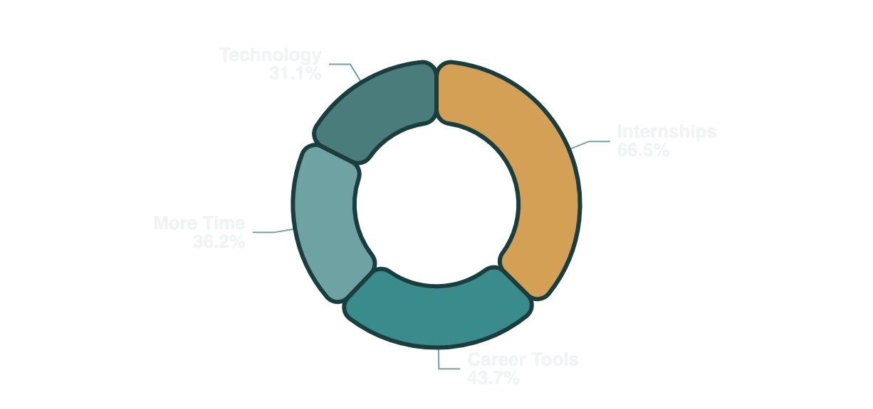
04 / PRIMARY LEVER
Experiential Learning: The Dominant Preparedness Lever
66.5%
Primary Preparedness Lever
906 respondents
Key Finding
Professional exposure is the single most desired factor for improving workplace readiness among Nigerian graduates, far outweighing academic or technological interventions.
Strategic Imperative
Complete Lever Hierarchy
"Internships must transition from 'optional extras' to institutionalized requirements within the higher education curriculum."
More internships & professional experience
66.5%
Better access to career preparation tools
43.7%
Why This Matters
Workplace familiarity reduces transition shock
More time for career preparation
36.2%
Professional networks accelerate job placement
Study technology
31.1%
Practical skills complement academic knowledge
Survey Item: "What would have made you feel more prepared?"
n = 1,363

Slide 7
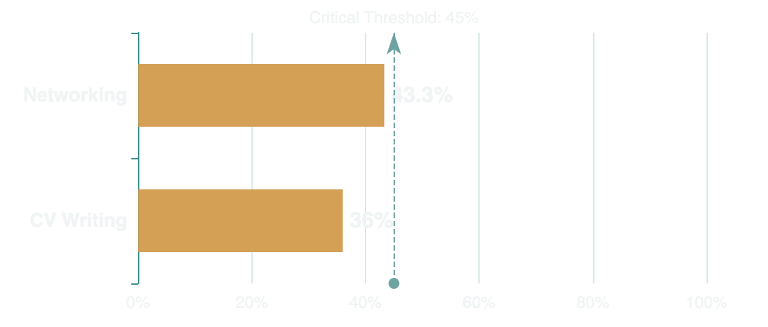
05 / HIDDEN BARRIER
Employability Signalling: The Hidden Barrier
The Signalling Deficit
A significant proportion of graduates lack the skills required to effectively signal their readiness to employers. This creates a communication gap between graduate capabilities and employer awareness.
36.0%
43.3%
Learned CV Writing
Networking Skills
Structural barrier to recruitment
Limited hidden job market access
Systemic Impact Pathway
The Hidden Job Market
1
Capability Exists
With only 43.3% acquisition of networking skills , graduates struggle to navigate the "hidden job market" where many opportunities reside.
Graduates possess valuable skills
70-80% of jobs are never publicly advertised
2
Signalling Failure
Cannot communicate value effectively
Critical Need
Academic excellence must be paired with transition literacy . Deliberate curricular embedding of signalling skills is essential for labor market success.
3
Talent Underutilization
Capable graduates remain unemployed
Derived from skills acquisition results
n = 1,363

Slide 8
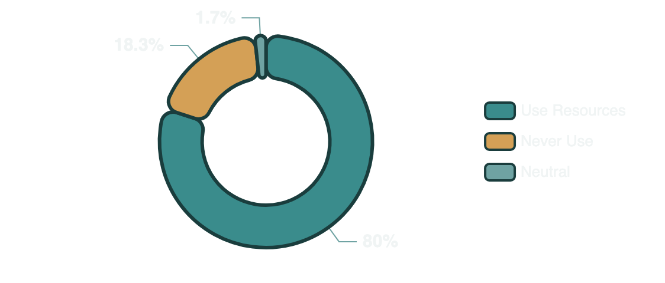
06 / UTILISATION PARADOX
Institutional Support: The Utilisation Gap
The Paradox
High perceived effectiveness does not guarantee high student engagement . Career resources are valued but underutilized.
80.0%
18.3%
Perceived Effectiveness
Non-Utilisation Rate
View as vital asset
Never use resources
Root Causes Analysis
Strategic Need
Siloed Structure
Institutions must bridge this gap by integrating career support into the formal curriculum rather than treating it as an optional extra. Career services require stronger governance and academic department integration.
Career services separated from academic core
Lack of Integration
Not embedded in formal curriculum
The Opportunity
Awareness Barriers
Closing the 18.3% non-utilisation gap could significantly improve graduate outcomes without requiring additional resource investment—just better integration and awareness.
Students unaware of available services
Accessibility Issues
Physical or digital access limitations
Survey Items: Career resources effectiveness & utilisation
n = 1,358

Slide 9
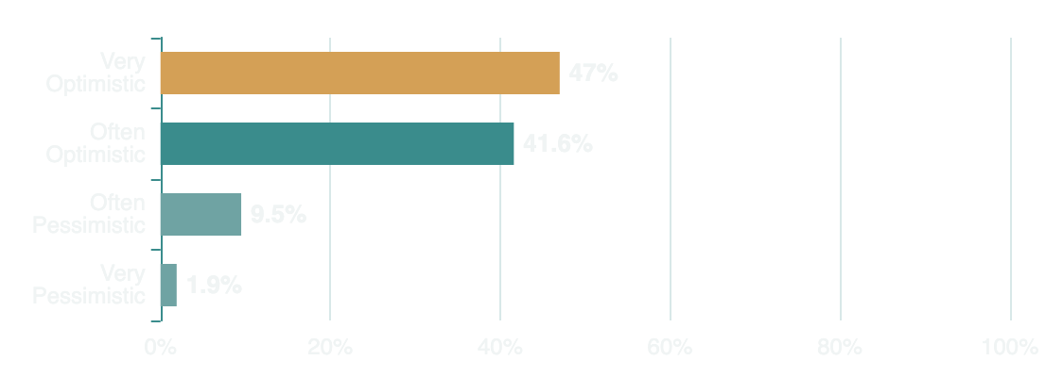
07 / GRADUATE PERSPECTIVES
Graduate Mindset: Optimism and Value Orientation
Resilience Amidst Challenges
Despite structural challenges in the Nigerian labor market, graduates exhibit strong resilience and optimism about their future careers. This indicates a mission-driven workforce seeking meaningful work.
Employment Optimism
88.6%
Values vs. Compensation
Total Optimism Rate
Prioritize passion over pay
77.3%
47.0%
41.6%
Very Optimistic
Often Optimistic
Prioritize societal impact over pay
55.2%
What This Signals
Strategic Implication
Graduates believe in their potential
Graduates prioritize purpose and passion over immediate financial gain, indicating a mission-driven workforce. Employers and institutions can align opportunities with these values to attract and retain talent.
Open to investing in skill development
Receptive to career guidance & support
Survey Items: Employment optimism & values orientation
n = 1,348 (optimism), n = 1,363 (values)

Slide 10
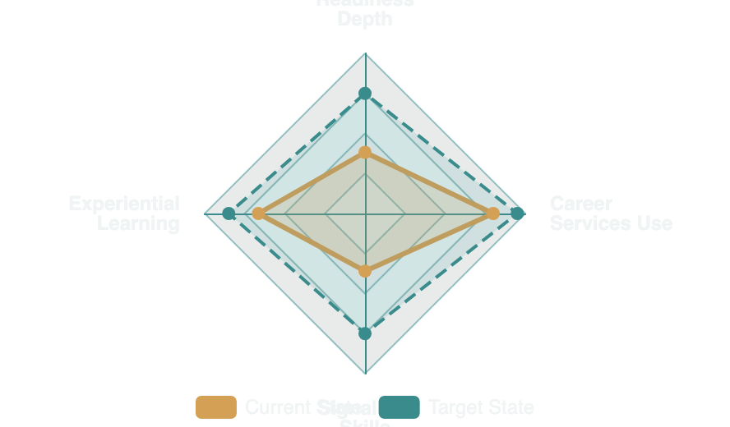
08 / SYNTHESIS
Structural Gaps: Four Critical Patterns
System-Level Design Challenge
Four structural patterns define the current state of graduate employability in Nigeria. These gaps establish employability not as an individual failure, but as a system-level design challenge requiring institutional intervention.
1
Readiness Gap
2
Lever Gap
Breadth Exceeds Depth
Exposure Dominance
88.8% prepared vs 38.2% very prepared
66.5% prioritize internships
Indicates lack of deep professional readiness
Critical need for experiential learning
Interconnected System
These gaps are not isolated —they form an interconnected system where weaknesses in one area amplify challenges in others. Addressing them requires coordinated, multi-dimensional intervention.
3
Skills Gap
4
Services Gap
Signalling Weakness
Utilisation Paradox
CV & networking below 45%
80% effective, 18.3% non-use
Barriers to labor market entry
Accessibility & integration issues
Core Insight
Employability is driven more by exposure, transition capability, and signalling than by academic content alone.
Synthesis of Workplace Readiness Survey (WRS) Round 1 Findings
n = 1,363

Slide 11
09 / STRATEGIC ROADMAP
Strategic Implications for Higher Education
IMPERATIVE 01
IMPERATIVE 02
Institutionalize Experiential Learning
Embed Signalling Skills
Move beyond optional internships. Make professional exposure a core, credit-bearing curricular requirement to ensure all graduates gain workplace familiarity.
Integrate CV writing, networking, and job search capability directly into the formal curriculum. Academic excellence must be paired with transition literacy.
Mandate internships for all programs
Require career communication courses
Establish employer partnership programs
Teach personal branding & LinkedIn
Create structured workplace immersion
Build networking skills progressively
IMPERATIVE 03
IMPERATIVE 04
Integrate Career Services
Outcome-Based Metrics
Transition career support from the periphery to the center of the student experience. Ensure stronger governance and integration with academic departments.
Shift focus from student satisfaction to employability outcomes . Use evidence-based diagnostics like WRS to drive institutional policy and design.
Embed career advisors in faculties
Track graduate employment rates
Create mandatory career checkpoints
Measure career readiness competencies
Establish peer career mentor programs
Align incentives with outcomes
Critical Success Factor: These imperatives must be implemented as an integrated system , not isolated initiatives. Coordination across academic affairs, career services, and institutional leadership is essential.
Strategic Roadmap for Nigerian Higher Education Stakeholders
Target: University Leaders & Policymakers

Slide 12

CONCLUSION & NEXT STEPS
Path Forward:
From Baseline to
Transformation
The Workplace Survey
Round 1 Baseline Diagnostic
Reference Year
2017
Round 1 has established a critical baseline , shifting the conversation from anecdotal concerns to evidence-based policy design for Nigerian Higher Education.
Valid Responses
1,363
Research Lead
Dr. O.A. Oludayo
1
Deeper Probing
Round 2 will investigate specific barriers to career resource utilization and the quality of internship experiences.
Empowering the next generation through evidence-based transformation
2
Refined Metrics
Enhanced tracking of graduate optimism and expectation measures to better align education with student values.
3
Systemic Tracking
Commissioned By
Target Audience
Nathan Leadgate Limited
Higher Ed Stakeholders
Continued longitudinal monitoring of preparedness and exposure indicators to measure intervention impact.
Workplace Readiness Survey (WRS) Programme
Evidence-Based Policy Design for Nigerian Higher Education

