Slide 1

WORKPLACE READINESS SURVEY
Round 2 Analysis
2018
Workplace Readiness
Survey Round 2
Nigerian Higher Education Graduate Employability Analysis
Scope
Analysis
Higher Education
Comparative (vs 2017)
Research Lead
Commissioned By
Program
Dr. Olumuyiwa A. Oludayo
Nathan Leadgate Limited
The Workplace Survey

Slide 2
EXECUTIVE SUMMARY
Key Findings at a Glance
Round 2 confirms high graduate confidence but reveals persistent structural gaps
Readiness Depth
Internships Dominance
Career Resource Use
42.0%
Very Prepared
70.8%
Key Lever
9.2%
Non-Use Rate
Up from 38.2% in Round 1 (+3.8pp), showing modest improvement in readiness depth.
Internships remain the most powerful readiness lever, increasing from 66.5% in Round 1.
Significant improvement from 18.3% in Round 1, indicating better resource adoption.
However, "unprepared" also rose to 7.1%
+4.3 percentage point increase
-9.1 percentage point decline
Effectiveness Decline
Signalling Deficit
Satisfaction Drop
76.6%
Effective
38.5%
Networking Skills
84.4%
Satisfied
Down from 80.0% in Round 1 despite higher utilization, revealing a service quality gap.
Down from 43.3% in Round 1. Signalling skills remain the most persistent deficit.
Down from 91.4% in Round 1, introducing reputational and engagement risk.
-3.4 percentage point decline
-4.8 percentage point decline
-7.0 percentage point decline

Slide 3
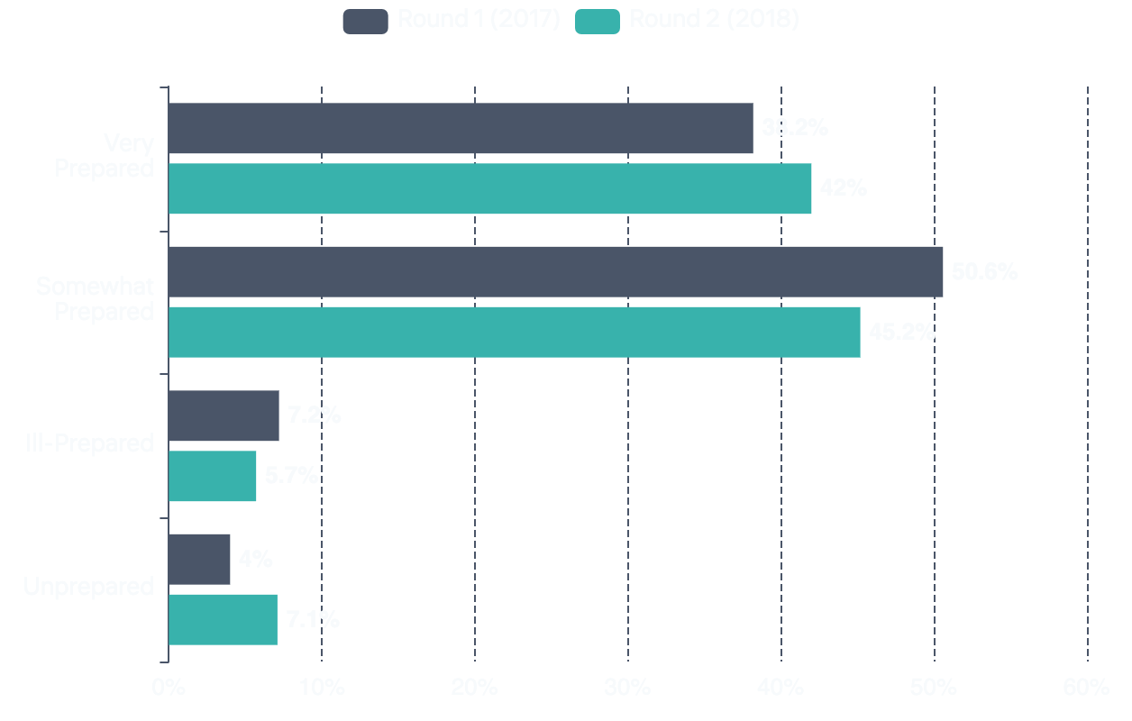
CONSTRUCT 1
Self-Perceived Workplace Readiness
A polarizing trend: readiness depth improves modestly but unevenly
Preparedness Distribution Comparison
Round 2 Distribution (2018)
Current
Very Prepared
42.0%
Somewhat Prepared
45.2%
Ill-Prepared
5.7%
Unprepared
7.1%
Key Insight
Readiness is polarizing, not uniformly improving. While "very prepared" increased by 3.8pp, "unprepared" also rose by 3.1pp.
Very Prepared: +3.8pp
38.2% → 42.0%
Somewhat Prepared: -5.4pp
50.6% → 45.2%
Unprepared: +3.1pp
4.0% → 7.1%

Slide 4
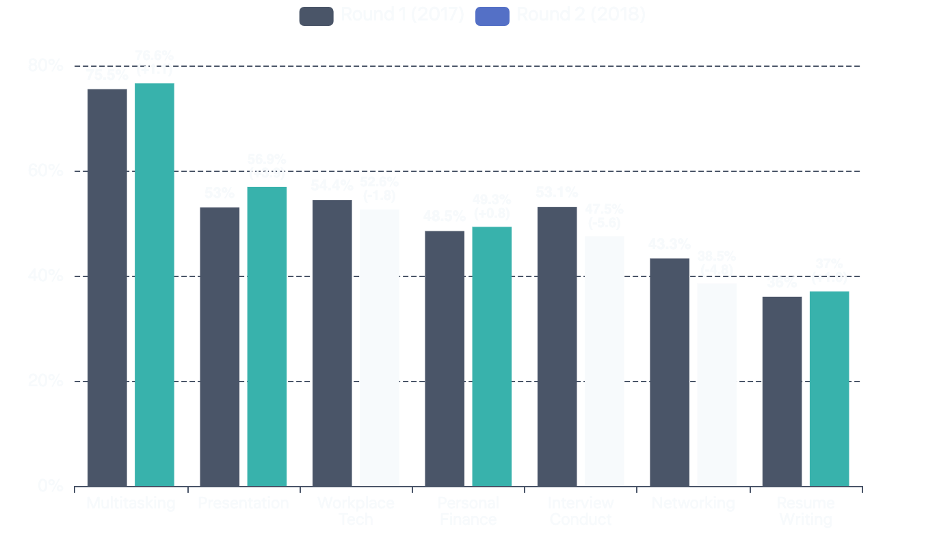
CONSTRUCT 2
Capability Formation: Skills Acquired
General capabilities strengthened while transition/signalling skills weakened
Skills Learned at University: Round 1 vs Round 2
Strongest Skills (Round 2)
Multitasking
76.6%
Presentation
56.9%
Workplace Tech
52.6%
Weakest Skills (Round 2)
Resume Writing
37.0%
Networking
38.5%
Interview Conduct
47.5%
Structural Gap: Signalling skills remain significantly weaker than general capabilities and have deteriorated further.

Slide 5
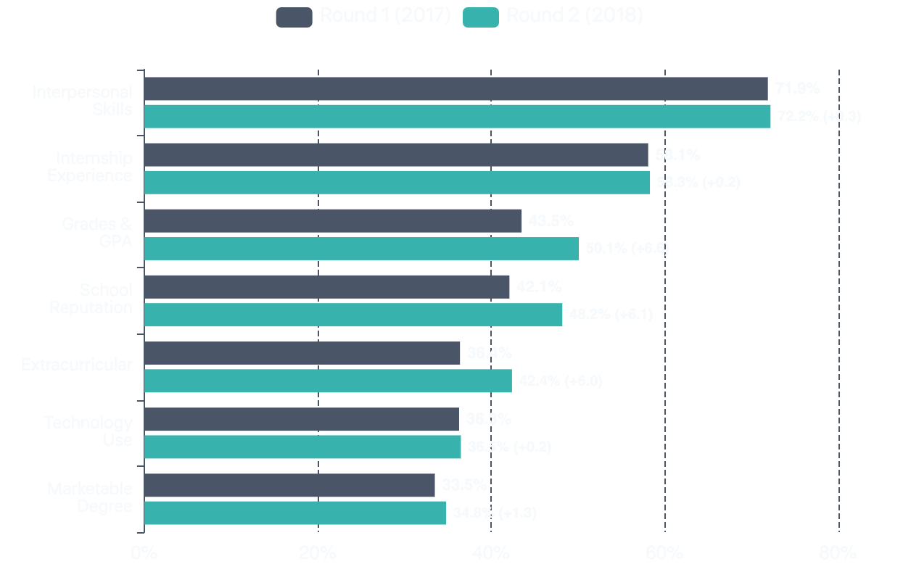
CAPABILITY FORMATION
What Makes a Good Job Candidate
Rising emphasis on credentials and institutional reputation in Round 2
Job Candidate Differentiators Comparison
Top Differentiators (Round 2)
1
Interpersonal Skills
72.2%
+0.3pp from R1
2
Internship Experience
58.3%
+0.2pp from R1
3
Grades & GPA
50.1%
+6.6pp from R1
Significant Increases (Round 2)
School Reputation
48.2%
+6.1pp
Extracurricular
42.4%
+6.0pp
Pattern: Round 2 shows stronger "credential and signalling by proxy" emphasis.

Slide 6
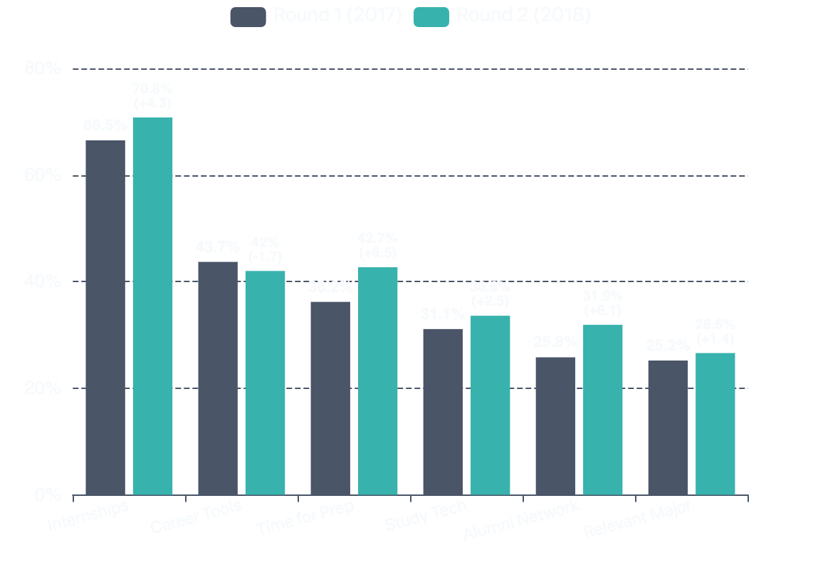
CONSTRUCT 3
Exposure & Experiential Learning
Internships remain the dominant lever; demand for time and alumni networking rises
What Would Make Respondents Feel More Prepared
Top Readiness Lever
DOMINANT
Internships & Professional Experience
70.8%
+4.3pp from Round 1 (66.5%)
Rising Demand Areas
More Time for Career Prep
42.7%
+6.5pp
Alumni Networking
31.9%
+6.1pp
Study Technology
33.6%
+2.5pp
Structural Meaning: Both time allocation and alumni networking demand increased by over 6pp, signaling evolving student needs.

Slide 7
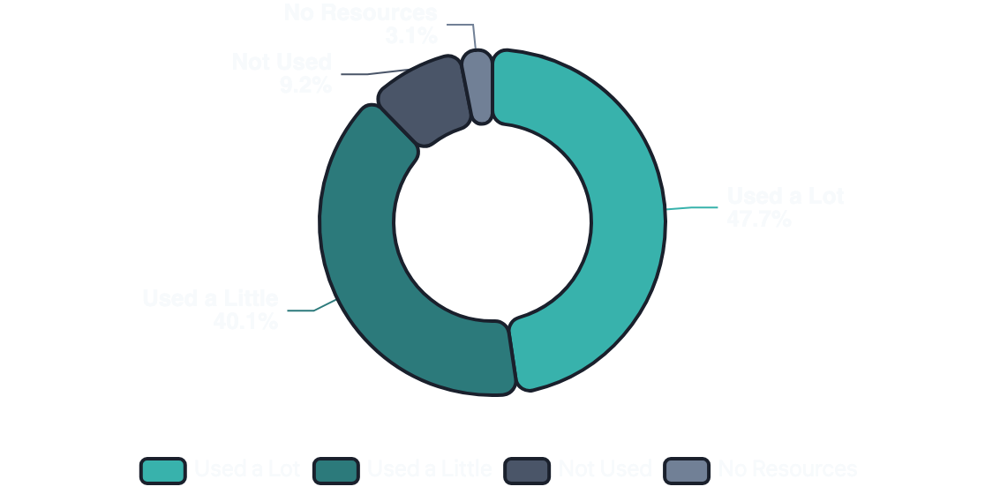
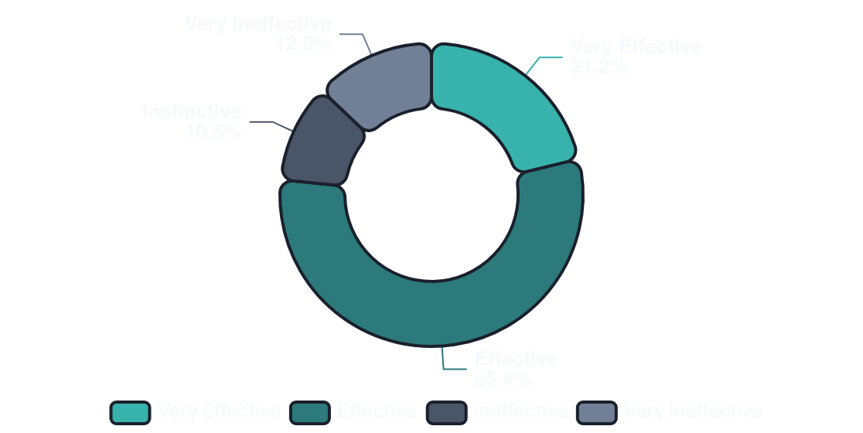
CONSTRUCT 4 & 5
The Career Services Paradox
Higher utilization alongside declining perceived effectiveness reveals capacity strain
Career Resource Utilization (Round 2)
Perceived Effectiveness (Round 2)
Non-use declined significantly: 18.3% → 9.2% (-9.1pp)
Effectiveness declined: 80.0% → 76.6% (-3.4pp)
The Paradox Explained
Career services are under pressure: While utilization improved substantially (non-use nearly halved), perceived effectiveness declined. This suggests capacity strain, quality variation, or misalignment between what is offered and what students actually need. The services are being used more, but not delivering proportional value.

Slide 8
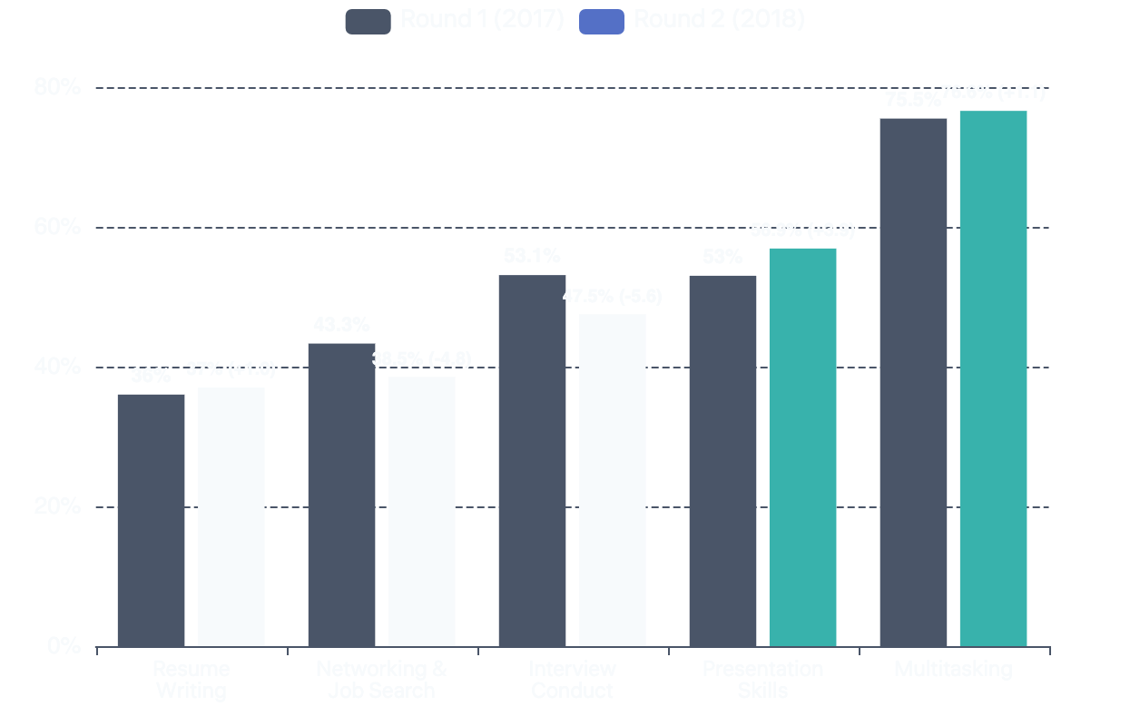
CONSTRUCT 4
Employability Signalling: The Persistent Deficit
Signalling skills remain weak and deteriorated further despite higher career service use
Signalling Skills Gap: Comparison with General Capabilities
Core Signalling Indicators (Round 2)
Resume Writing
37.0%
+1.0pp
from 36.0%
Networking & Job Search
38.5%
-4.8pp
from 43.3%
Interview Conduct
47.5%
-5.6pp
from 53.1%
Key Insight
Signalling skills not only remain weak but have deteriorated on key items (networking -4.8pp, interview conduct -5.6pp) despite higher career service utilization.
This suggests misalignment between service use and actual skill deficits .

Slide 9
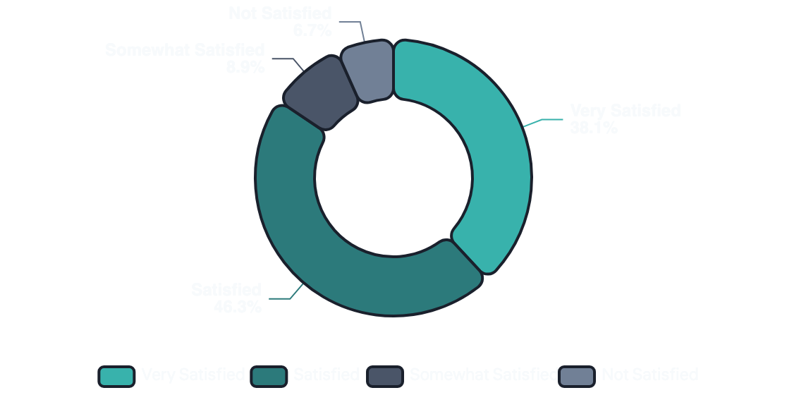
CONSTRUCT 7
University Experience & Satisfaction
Material decline in satisfaction introduces reputational and engagement risk
Overall Satisfaction Distribution (Round 2)
University Choice Factors (Round 2)
1
Value for Money
37.2%
2
Academic Quality
23.9%
3
Prestige & Reputation
16.9%
4
Cost
10.7%
5
Job Placement
6.4%
Key Comparison
Round 1 (2017)
Round 2 (2018)
91.4%
84.4%
Satisfied
Satisfied
Critical Insight: Satisfaction declined materially while some readiness indicators improved, reinforcing that employability requires distinct measurement from satisfaction metrics.
-7.0 percentage points

Slide 10
CONSTRUCT 6
Career Values & Expectations
Purpose orientation remains strong but shows early signs of moderation
Values & Job Preferences
Perceived Opportunities (Round 2)
Prefer Societal Impact Over Pay
1
Opportunities in Many Fields
54.0%
Round 1: 55.2%
Round 2: 54.9%
2
Skills in High Demand
29.0%
-0.3pp (stable)
3
Established Career Path
11.8%
"Doing What I Love" More Important Than Pay
Round 1: 77.3%
Round 2: 73.3%
4
Companies Recruit Directly
5.2%
-4.0pp (moderation)
Note: Round 1 reported 86.2% felt high opportunities, but item equivalence is uncertain. Round 2 shows more nuanced distribution.
Interpretation: Purpose orientation remains strong but shows early signs of moderation, possibly reflecting economic realities.
Course-to-Job Confidence (Round 2)
41.2% agreed they are happy with their major but not sure it will get them a job, while 58.8% disagreed. This signals a moderate level of confidence in the direct employability link of their chosen field of study.

Slide 11

SYNTHESIS
Five Key Structural Gaps Identified
Evidence-based patterns from Round 2 comparative analysis
1
Readiness Polarization
2
Exposure Dominance
Readiness depth improved modestly (very prepared +3.8pp), but polarization increased as "unprepared" also rose (+3.1pp). Progress is uneven, not universal.
Internships remain the single most powerful employability lever at 70.8% (+4.3pp). Demand for structured time and alumni networking is also rising significantly.
3
Signalling Deficit
4
Career Services Paradox
Employability signalling is the most persistent deficit across rounds. Networking (-4.8pp) and interview conduct (-5.6pp) deteriorated despite higher career service use.
Career services show a utilization-effectiveness paradox: non-use nearly halved (-9.1pp) but perceived effectiveness declined (-3.4pp), revealing capacity strain.
5
Satisfaction Decline Risk
University satisfaction declined materially (-7.0pp), introducing reputational and engagement risk even as some readiness indicators improved. This decoupling signals that satisfaction cannot substitute for employability measurement.

Slide 12

STRATEGIC IMPLICATIONS
Recommendations for Nigerian Higher Education
Embed Internships Structurally
Round 3 Design Recommendations
Internships must be core design elements, not peripheral add-ons. With 70.8% citing internships as the top readiness lever, institutions must integrate experiential learning into curricula.
1
Deepen Segmentation
Add demographic cross-tabs by discipline, level, internship participation, and service usage intensity.
2
Service Type & Outcomes
Explicit Signalling Curriculum
Separate utilization by service type, frequency, and perceived skill gains to address the paradox.
Employability signalling should be curriculum-adjacent capability, assessed and practiced, not treated as optional coaching. Resume writing, networking, and interview skills need structured development.
3
Competency Scales
Add quantified competence measures for workplace literacy and applied competences.
Career Services Reset
4
Fix Instrument Integrity
Career services require capacity and quality recalibration to match rising utilization. The utilization-effectiveness paradox signals misalignment between service design and actual student needs.
Ensure clean response options and validation rules for expectations and optimism metrics.
Separate Employability Metrics
Satisfaction metrics must not substitute for employability indicators. The decoupling of satisfaction (-7.0pp) from readiness improvements reinforces the need for distinct measurement systems.
Core Finding
Employability outcomes are shaped more by exposure, signalling, and support system quality than by academic satisfaction alone.
Workplace Readiness Survey Programme | Round 2 Analysis (2018) | Nigerian Higher Education

