Slide 1

Research Report 2019
Workplace Readiness Survey
Round 3
A Comprehensive Analysis of Graduate Employability, Transition Expectations, and Institutional Support Systems in Nigerian Higher Education
Principal Researcher
Survey Period
Dr. Olumuyiwa Oludayo
2019
MCIPM, FITD
1,027 Respondents

Slide 2
Report Structure
Report Overview
01
Study Methodology & Respondent Profile
02
Core Findings: Readiness & Preparation
Research framework, sample composition, and demographic analysis across 1,027 survey participants
Critical analysis of readiness breadth vs. depth, experiential learning dominance, and skills acquisition patterns
04
Longitudinal Analysis & Statistical Inference
03
Career Support Systems & Digital Behavior
Institutional support effectiveness, digital job search patterns, and multidimensional career fulfilment expectations
Three-round trend analysis (2017-2019), convergence findings, and key statistical associations
05
Implications & Strategic Recommendations
Evidence-based guidance for higher education institutions, employers, and policy makers

Slide 3
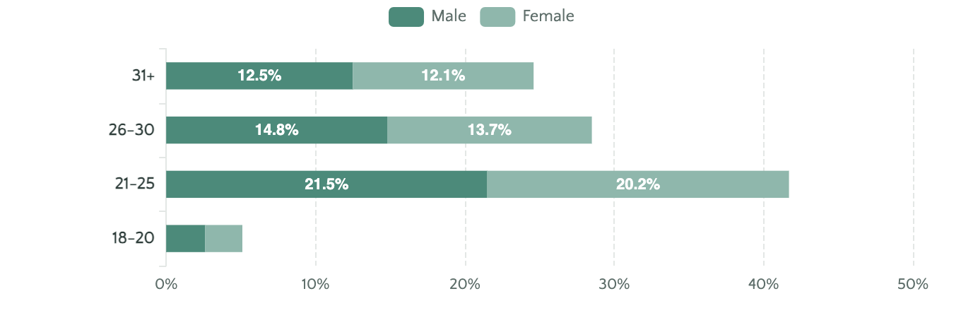
Section 01
Study Methodology & Sample Profile
Sample Composition
Respondent Demographics
Total Records
1,027
Valid Responses
1,016
Missing Data
11
Analytical Approach
Sex Distribution
Education Status
Institution Type
1
Descriptive Statistics
51.4% Male
53.9% Post-Grad
37.1% Private
Distribution, frequency, and percentage analysis
48.6% Female
27.2% Recent Grad
36.4% Federal
2
Multi-Response Analysis
Near-balanced sample
Transition-focused
University-dominated
Decomposition of "select all that apply" items
3
Cross-Tabulation
Subgroup comparison and chi-square tests
Age Profile
41.7%
28.5%
70.2%
4
Effect Size Measurement
21-25 years
26-30 years
Ages 21-30
Cramér's V for categorical associations

Slide 4
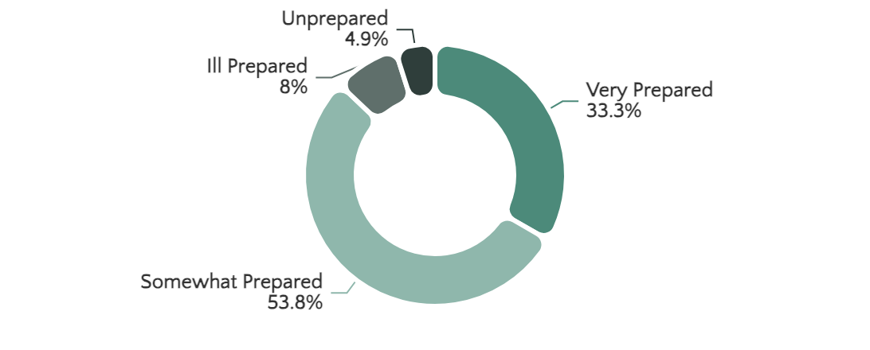
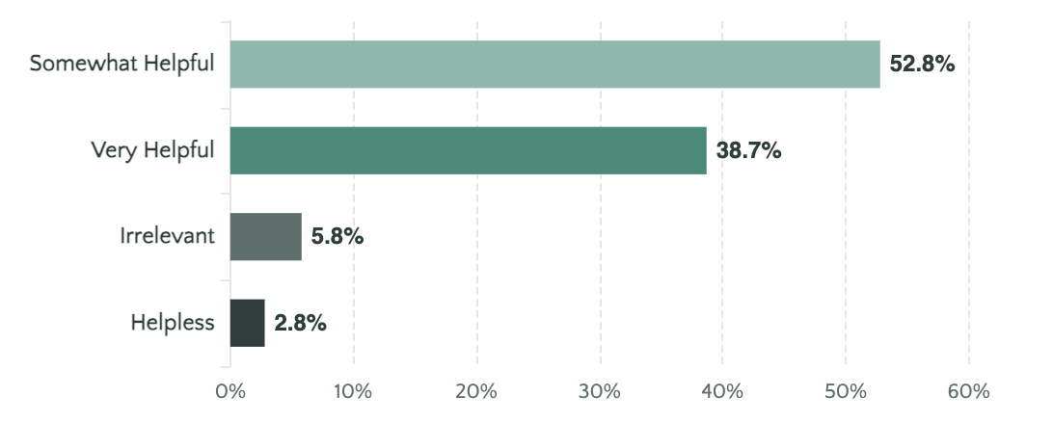
Section 02 • Critical Finding
Readiness Assessment: Breadth vs. Depth
Self-Perceived Readiness Distribution
School Experience Helpfulness
At Least Somewhat Prepared
Very Prepared
Key Insight: The Readiness Gap
87.1%
33.3%
1
High Institutional Confidence
Readiness Breadth
Readiness Depth
91.4% rate school experience as helpful, showing positive institutional perception
2
Moderate Self-Assessment
The "Somewhat Prepared" Majority
Only 33.3% feel "very prepared" despite positive school ratings
53.8% fall into the middle category, indicating the system produces partial confidence rather than robust labour market readiness
3
Structural Concern
The problem is insufficient readiness intensity, not total unreadiness

Slide 5
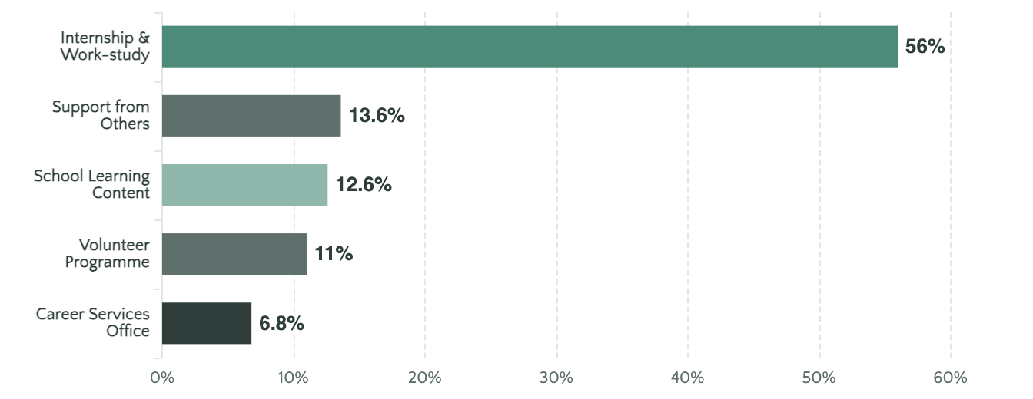
Section 02 • Key Finding
The Dominance of Experiential Learning
Most Helpful Source of Preparation
What Would Improve Preparedness?
More internships & experience
75.9%
Better career preparation tools
40.2%
Career development centres
38.4%
More relevant course of study
18.3%
Getting better grades
11.2%
Central Insight
Academic Performance vs. Practical Exposure
Respondents do not see employability as a matter of grades alone. Getting better grades (11.2%) is far less prominent than practical exposure, career preparation tools, and institutional transition support.
Internships and work-study programmes are not merely one contributor among many. They are the overwhelmingly dominant preparation mechanism, outperforming all other sources combined. This establishes experiential learning as the central employability lever.

Slide 6
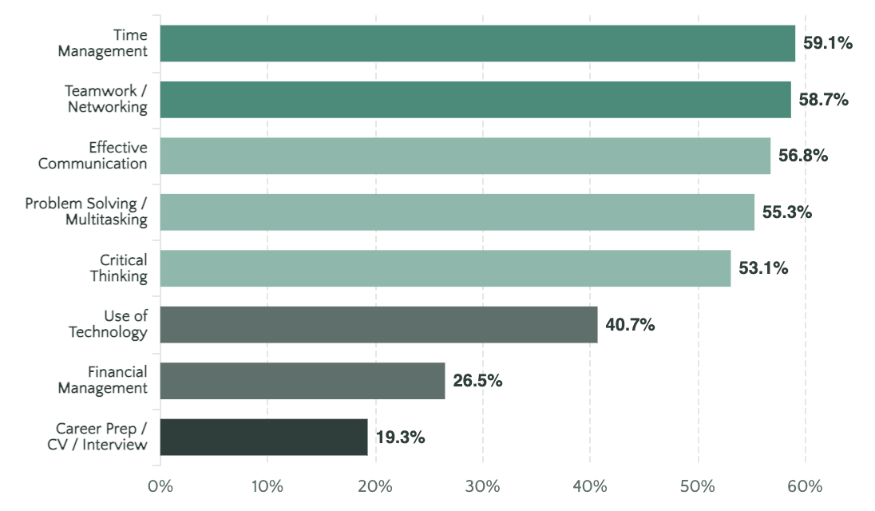
Section 02 • Critical Gap
Skills Acquisition & The Signalling Gap
Skills Learned in School (Multi-Response)
The Structural Distinction
Capability Formation Skills
Institutions appear to teach general academic and behavioural skills at moderate scale (50-60% acquisition rates)
Transition & Signalling Skills
Remain substantially under-taught with only 19.3% reporting career preparation skill acquisition
Implications for the Signalling Gap
1
Not incidental — it is structural and persistent across all three survey rounds
Strong Areas
Critical Weakness
2
Graduates learn how to work better than how to get hired
55-59%
19.3%
Time management, teamwork, communication, problem-solving
Career preparation, CV writing, interview preparation
3
Creates a conversion bottleneck between competence and labour market visibility

Slide 7
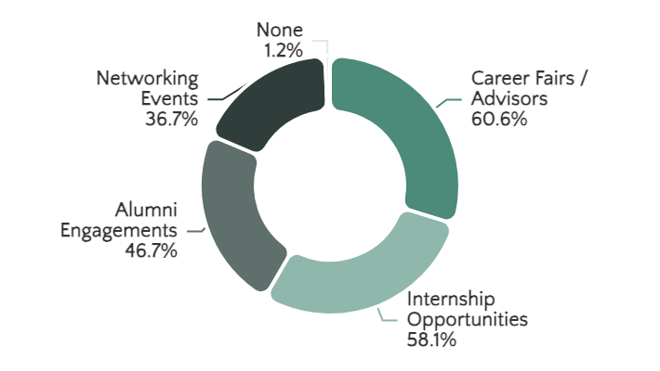
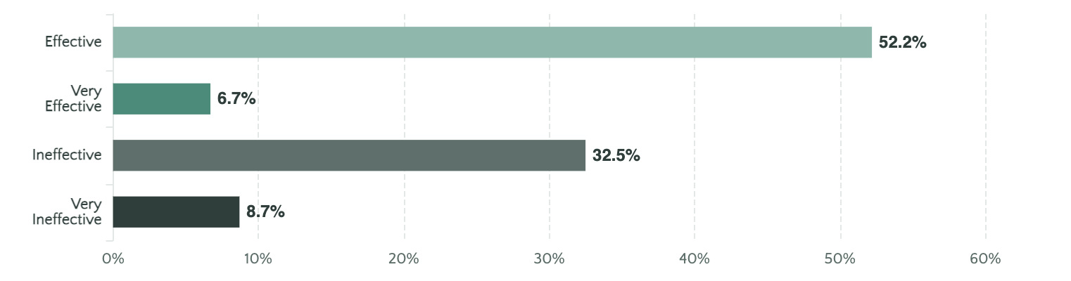
Section 03 • Institutional Support
Career Support Systems: Present but Not Robust
Available Career Resources
Perceived Effectiveness of Career Resources
Mode of Access
Positive Effectiveness
Negative Effectiveness
58.9%
41.1%
In-person
46.9%
Effective (52.2%) + Very Effective (6.7%)
Ineffective (32.5%) + Very Ineffective (8.7%)
Online
24.5%
Statistical Association with Readiness
Not applicable
28.6%
Chi-square test shows significant association between career resource effectiveness and self-perceived readiness: χ² = 118.77, p < 0.001, Cramér's V = 0.197. Respondents rating resources as "Very Effective" show 77.9% "Very Prepared" rate vs. 20.9% for "Ineffective".

Slide 8
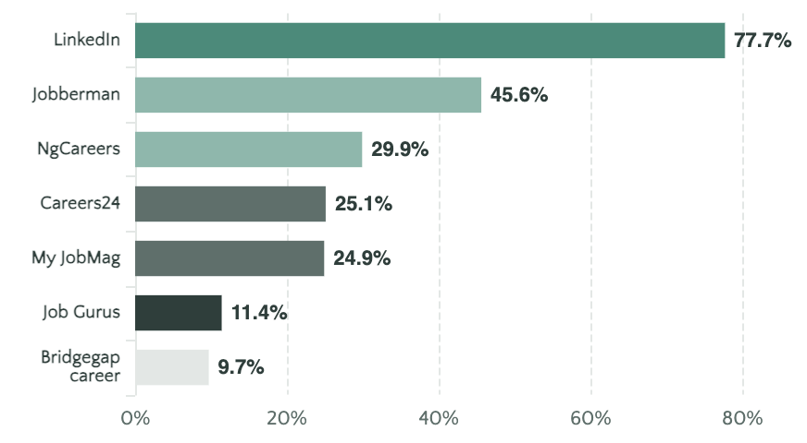
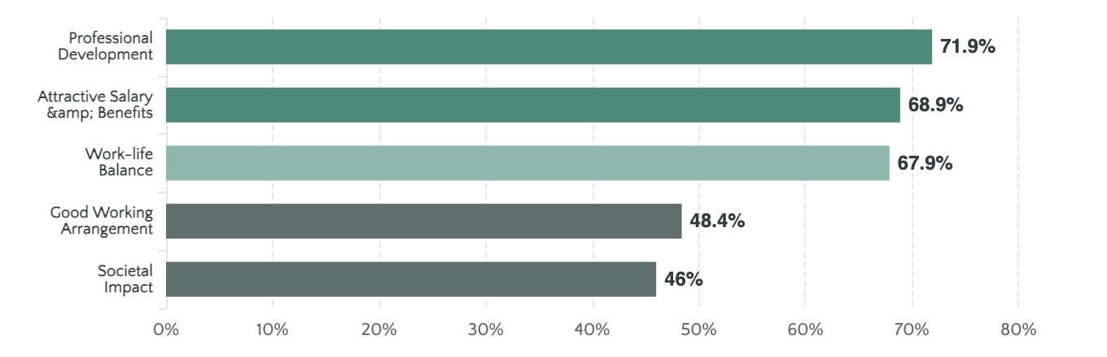
Section 03 • Digital Landscape
Digital Job Search Behavior & Career Fulfilment
Job Search Platform Usage
Career Fulfilment Expectations (Multi-Response)
Digital Employability is No Longer Optional
Compound Fulfilment Model
Platform Combinations
Respondents are not merely employment-seeking. They are optimising for a broader career experience that includes growth, sustainability, reward, meaning, and workable conditions.
LinkedIn only
24.1%
The job search ecosystem is decisively digital. Graduates must know how to build professional online identity, search strategically, and present themselves credibly in digital environments.
LinkedIn + Jobberman
8.7%
Jobberman only
4.8%

Slide 9
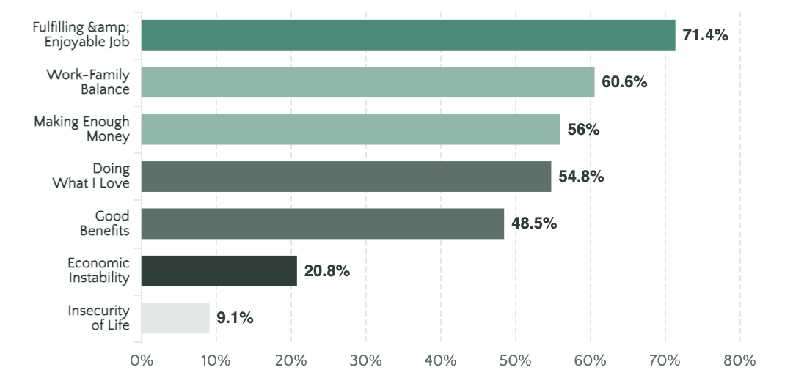
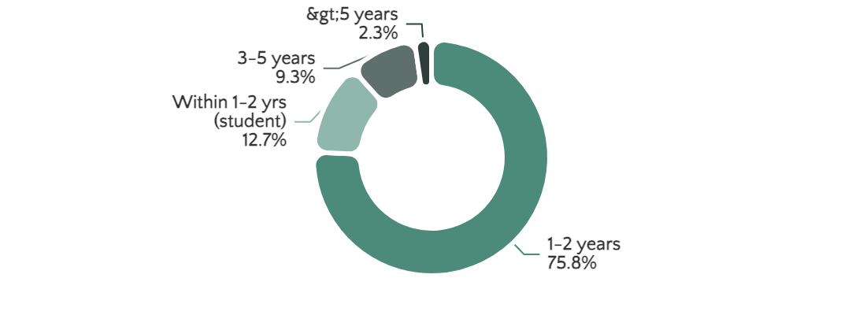
Section 03 • Post-School Reality
Life After School Concerns & Transition Outcomes
Post-School Concerns (Multi-Response)
Time to Get a Job After Graduation
Slow Transition Reality
The dominant employment transition window is 1 to 2 years after graduation. For a labour market transition system, this is slow. The data suggest a prolonged absorption period rather than an efficiently functioning bridge from higher education to work.
Quality-of-Life Concern Structure
The dominant concern profile is not survival-only. Respondents are entering the labour market with expectations that are developmentally richer than many institutions may assume.
Expected Duration in First Job
40.6%
31.5%
88%
1-2 years
3-5 years
≤5 years
First job viewed as transition platform, not final destination

Slide 10
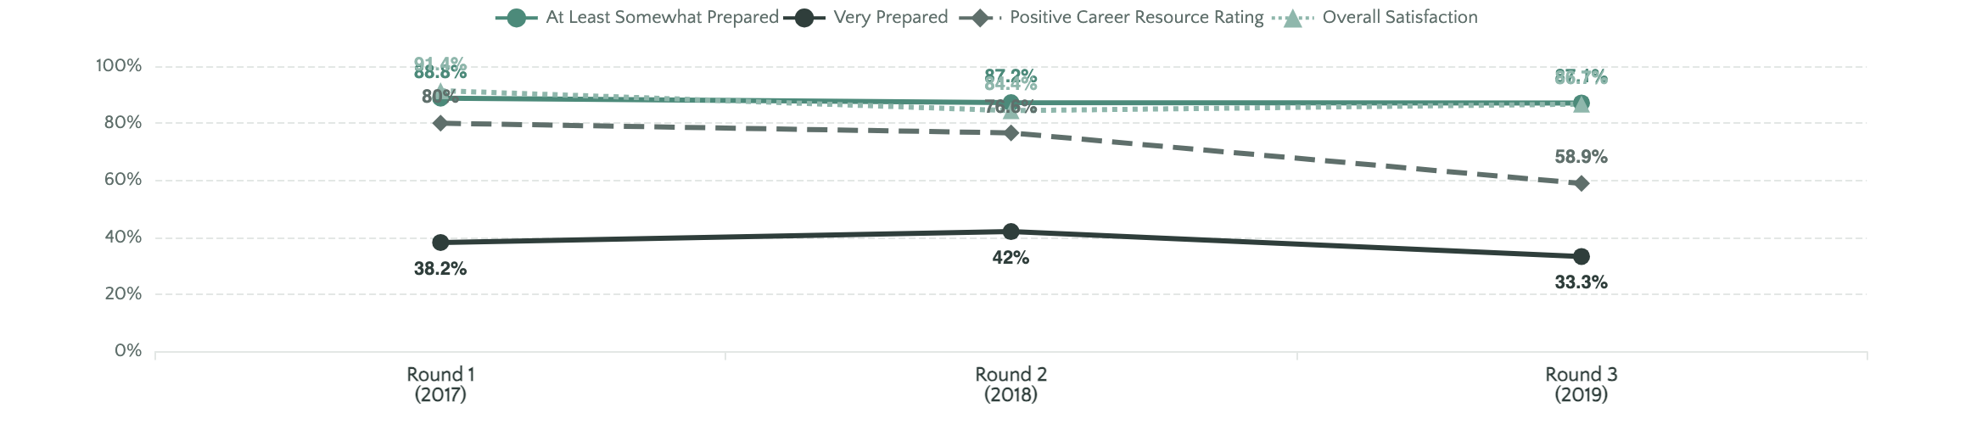
Section 04 • Trend Analysis
Longitudinal Analysis: Three-Round Trends (2017-2019)
Comparative Summary of Core Indicators
Five Key Convergences
Three Key Divergences
1
Readiness breadth exceeds depth — stable across all rounds
Readiness Depth Instability
2
Exposure remains strongest lever — most stable finding
Round 2 improvement (42.0%) did not hold in Round 3 (33.3%). System has not institutionalised deep readiness consistently.
3
Signalling remains underdeveloped — structural gap persists
Career Support Deterioration
4
Satisfaction ≠ employability — consistent tension
Positive ratings declined from 80.0% (R1) → 76.6% (R2) → 58.9% (R3). System inconsistency problem.
5
Values broader than pay — purpose-aware workforce
Value Framing Maturation
Graduate aspiration becoming more sophisticated with layered structure: challenge, passion, development, balance, benefits, impact.

Slide 11
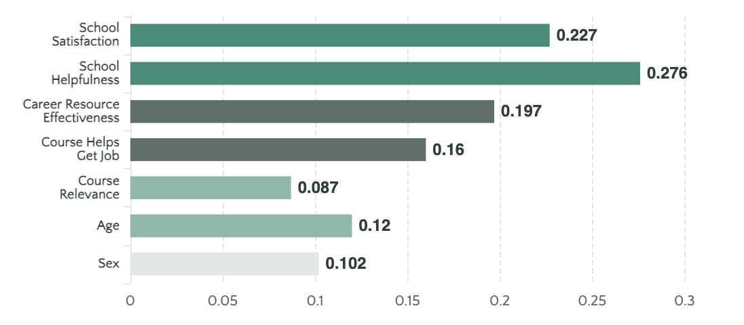
Section 04 • Inferential Analysis
Statistical Inference & Key Associations
Strongest Statistical Associations with Readiness
Readiness by Institution Type
Polytechnic
63.2%
State University
46.3%
Federal University
33.5%
Private University
19.9%
χ² = 87.96, p < 0.001, Cramér's V = 0.170
Emerging Explanatory Proposition
Graduate readiness is not determined mainly by academic participation alone, but by how effectively the educational system combines exposure, support, and signalling into a functioning transition pathway.
Readiness by Career Resource Effectiveness
Very Effective
77.9%
Effective
34.3%
Very Ineffective
38.6%
Ineffective
20.9%
χ² = 118.77, p < 0.001, Cramér's V = 0.197

Slide 12

Section 05 • Conclusion
Strategic Implications & The Path Forward
For Higher Education Institutions
For Employers
For Policy Makers
A
Redesign Employability Around Exposure
Do not assume graduates lack intelligence or commitment simply because they struggle in the labour market.
A national employability strategy cannot be built around curriculum reform alone. The strongest variables involve exposure, transition support, signalling, and institutional conversion capacity.
Make internships compulsory, quality-monitored, credit-bearing, and integrated into employability measurement
B
Teach Signalling Explicitly
Key Insight
Career preparation, CV writing, interview skills, and networking should be taught and assessed as formal transition skills
Many graduates may be better described as under-signalled than under-capable.
1
Pay greater attention to employability infrastructure
C
Replace Peripheral Career Services
2
Develop and support internship ecosystems
Move from "career office" logic to "transition system" logic with integrated support infrastructure
Offer structured internships and graduate transition programmes
3
Establish transition support standards
D
Use Outcome Metrics
Develop practical assessment systems that evaluate capability beyond credentials
Judge performance using employment outcomes, time to work, career relevance, and transition support quality
4
Implement robust graduate outcome measurement systems
Build work readiness partnerships with institutions
Central Contribution of Round 3
Nigerian higher education produces broad readiness, but does not yet consistently produce deep, conversion-ready, transition-effective employability. The bottleneck lies in the space between learning and labour market visibility, institutional experience and selection readiness, confidence and conversion, graduation and timely workforce entry.

